Slide 1
Risk system

Slide 2
Idea: what if we could predict volatility
Underlying theory: future volatility is determined by past volatility. There is a „true“ underlying relationship that is constantly evolving.
For this to be true, we need to test for heteroskedacity and stationarity in the price data.
GARCH model family: takes into account recent volatility shocks, past returns^2 and a residual. Fits this onto data to predict next volatility. Individual models differ slightly. Intraday price data needed.
HAR model family: an OLS regression on the averages of past returns squared. Uses this to predict next day.

Slide 3
How do you evaluate the models
MSE = (1/n) * sum((forecasted variance - realised variance)^2)
QLIKE = log(forecasted variance) + (realised variance / forecasted variance)
Find smallest levels of error to true volatility, this model will be best

Slide 4
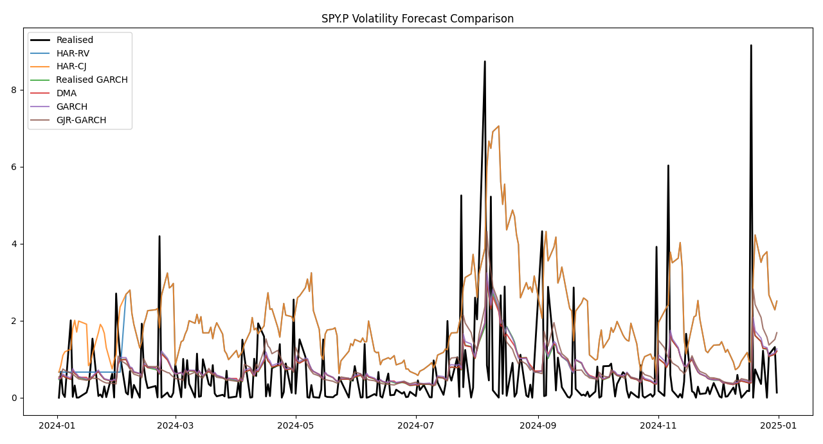
S&P 500

Slide 5
Idea: see when correlation breaks down
For this, I developed 3 different types of correlation filters
Rolling correlation – raw correlation between stocks
Partial correlation – correlation between 2 stocks, controlling for another.
Dynamic conditional correlation – needs GARCH as an input, and is very good for measuring intercorrelation within the portfolio

Slide 6
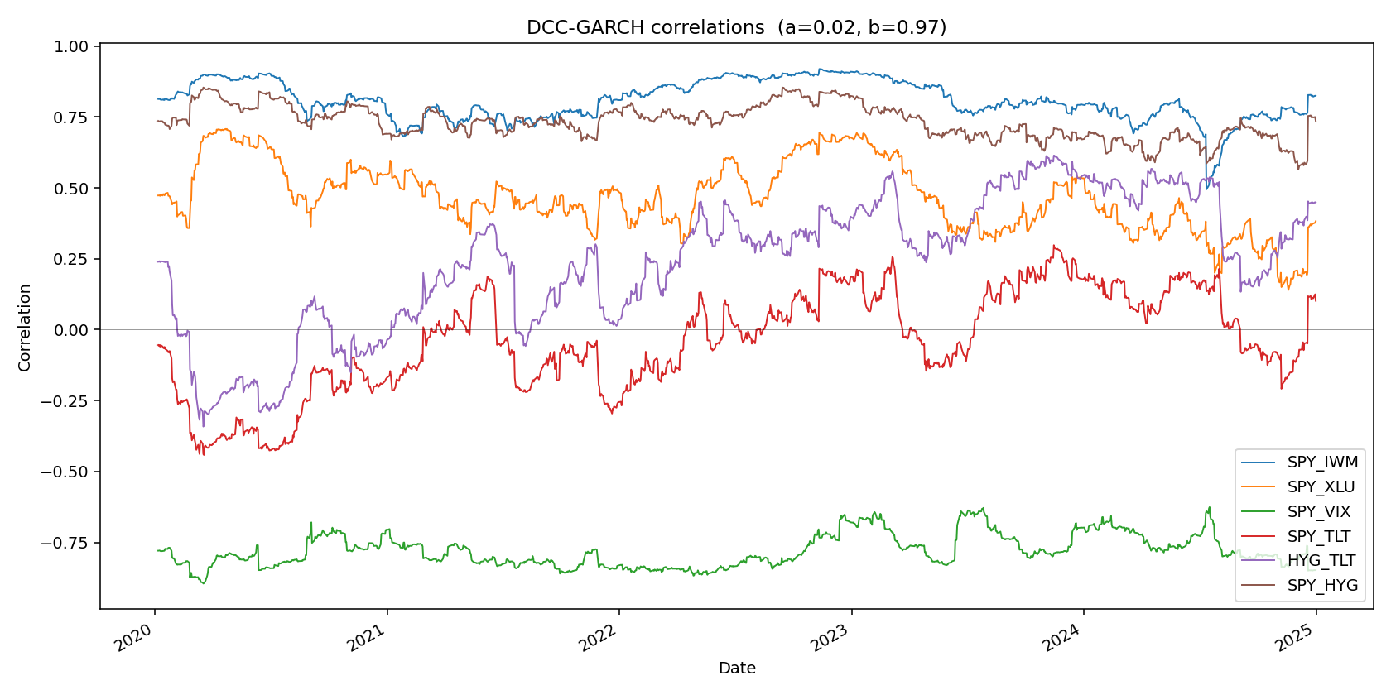
DCC GARCH

Slide 7
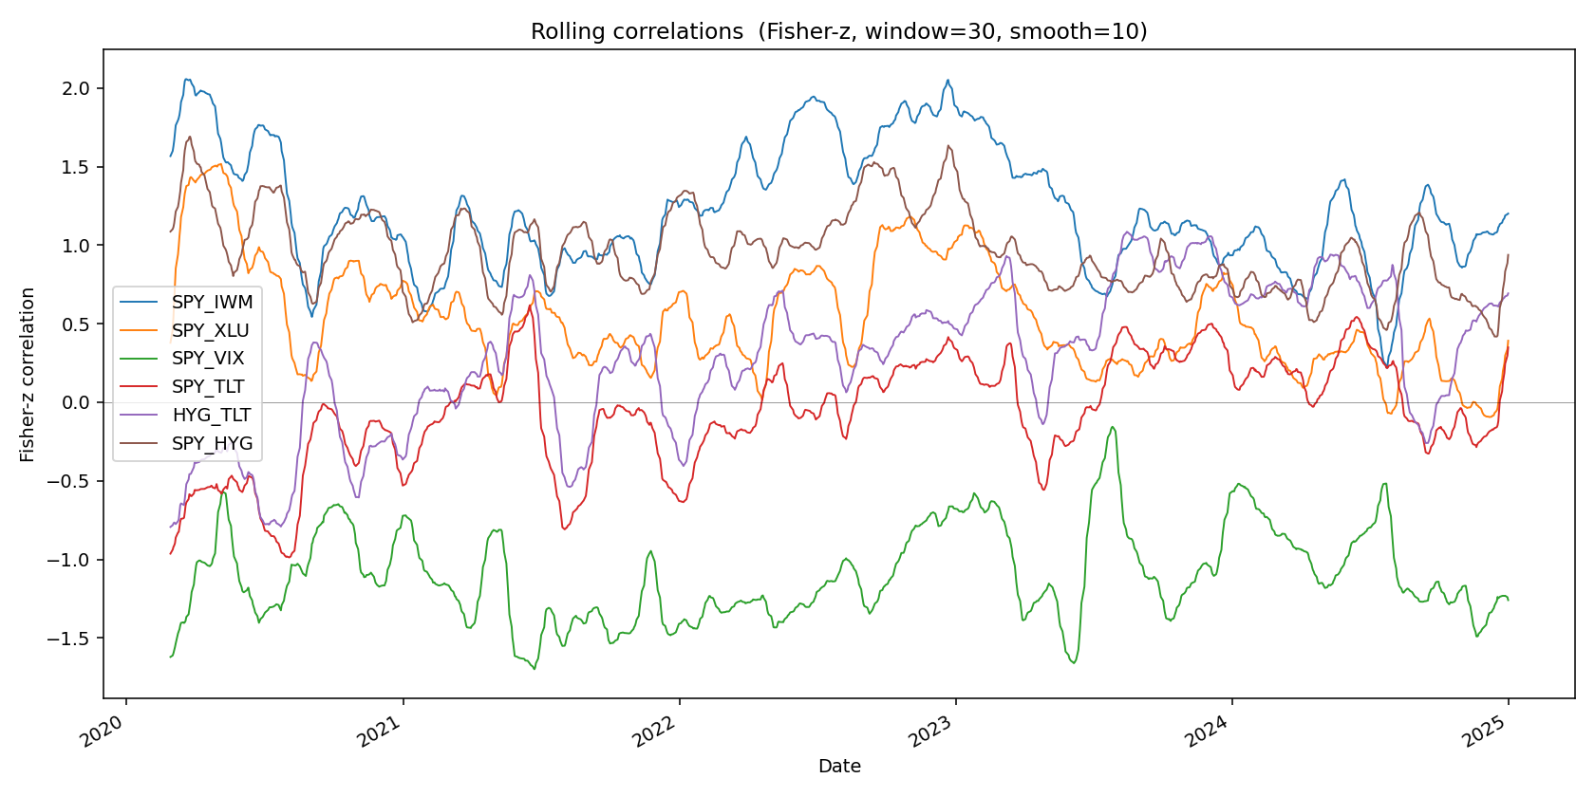
Rolling correlation

Slide 8
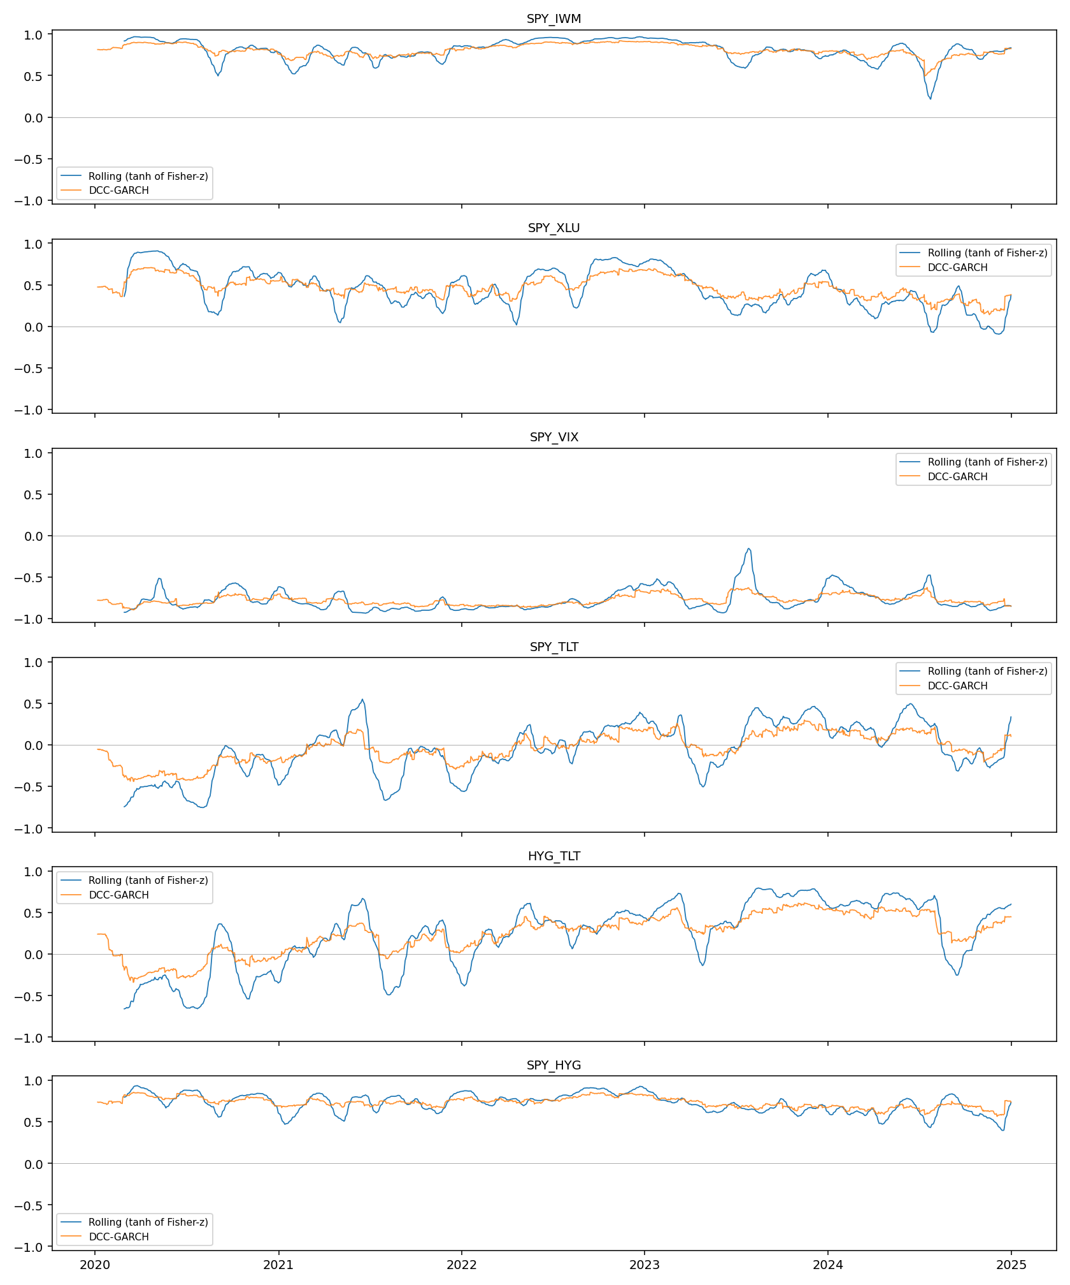
Rolling vs DCC

Slide 9
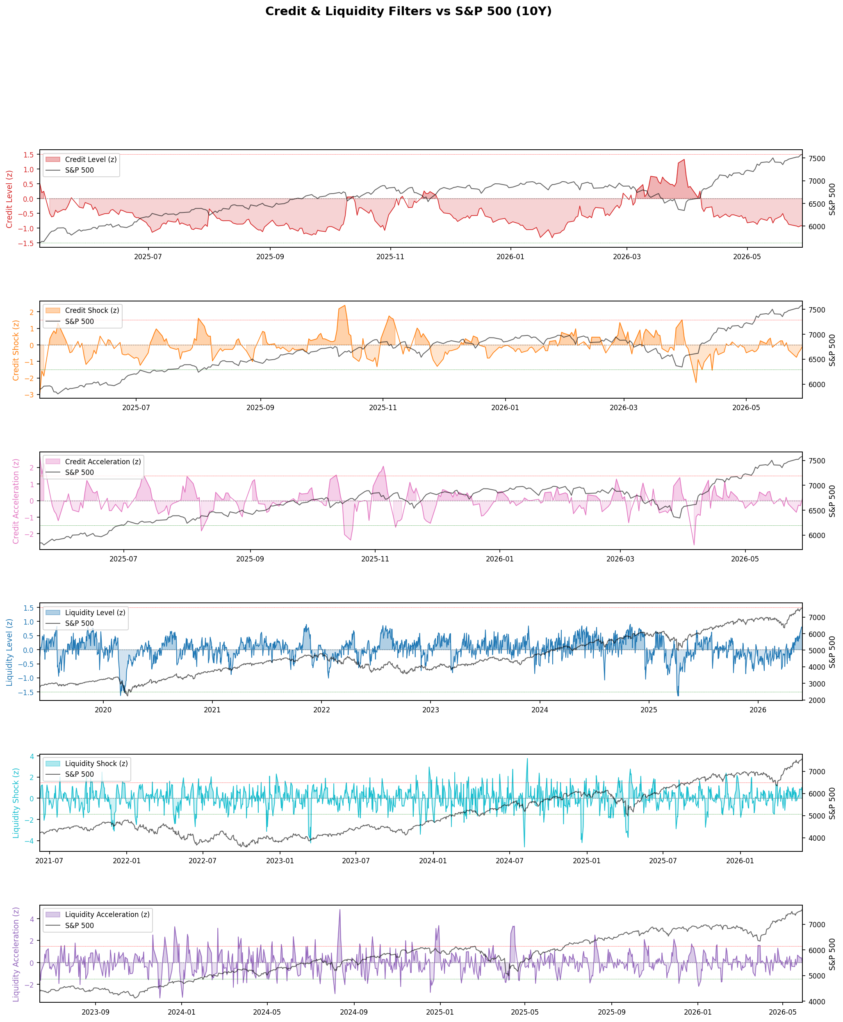
Idea: notice credit and liquidity issues
Liquidity level, shock, and acceleration. (Volume S&P traded)
Credit spread level, shock, acceleration(ICE BofA HY OAS from FRED (BAMLH0A0HYM2)

Slide 10
Idea: predict and detect trends
Kalman Filters, particle filters, benchmarks such as SMA. The ground truth is the Hodrick Prescott filter.

Slide 11
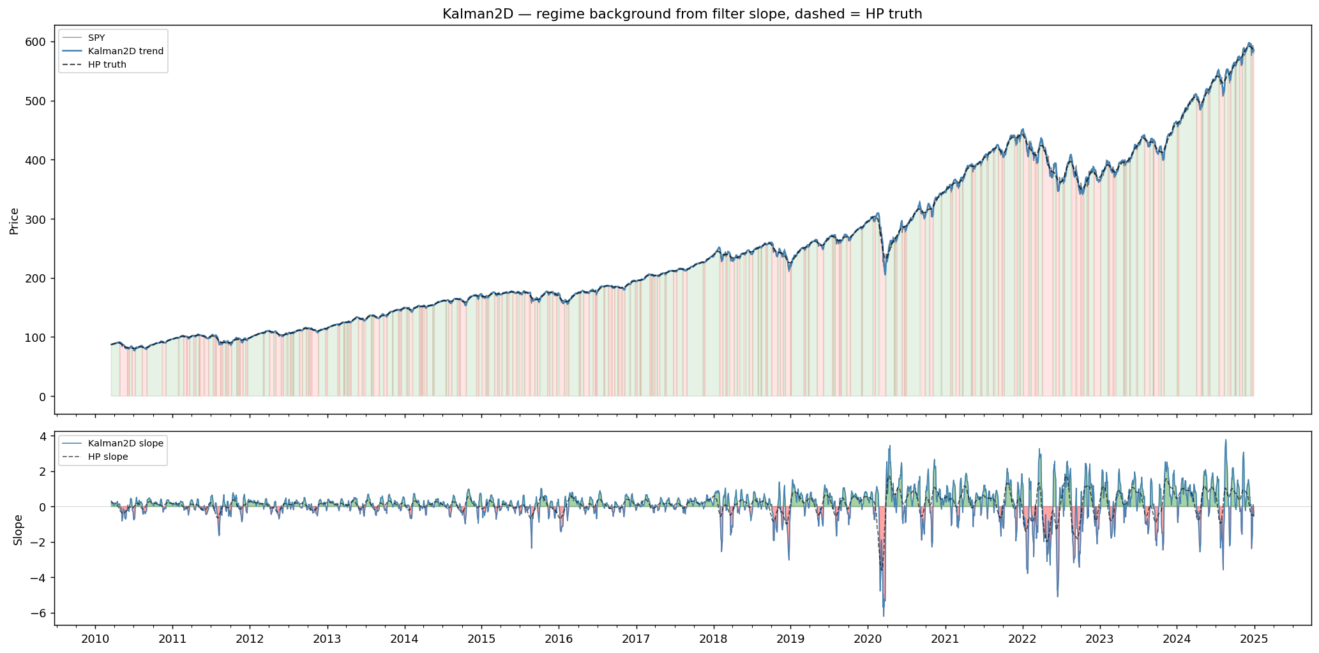
Kalman 2D – simplest version

Slide 12
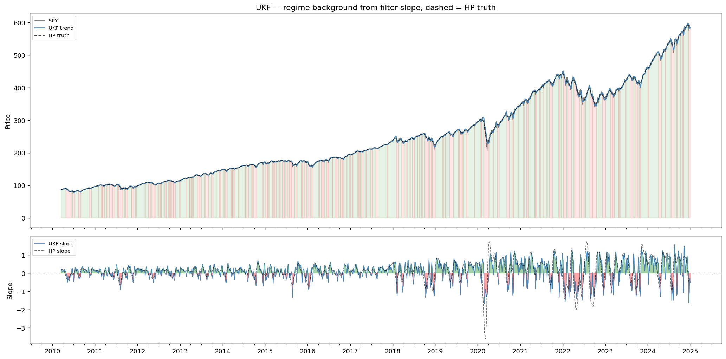
Unscented Kalman Filter

Slide 13
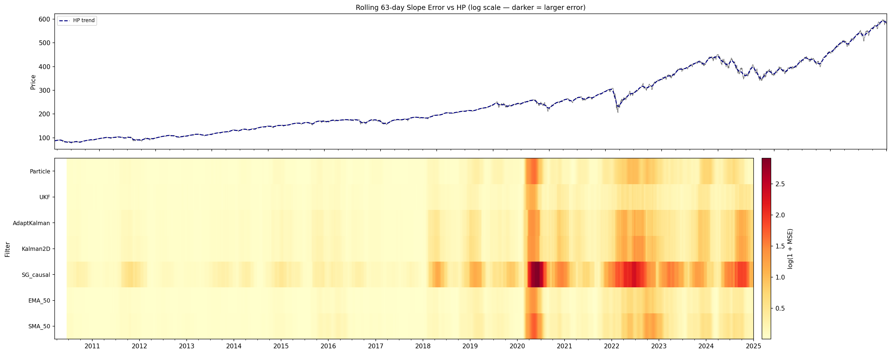
Rolling error of all models

Slide 14
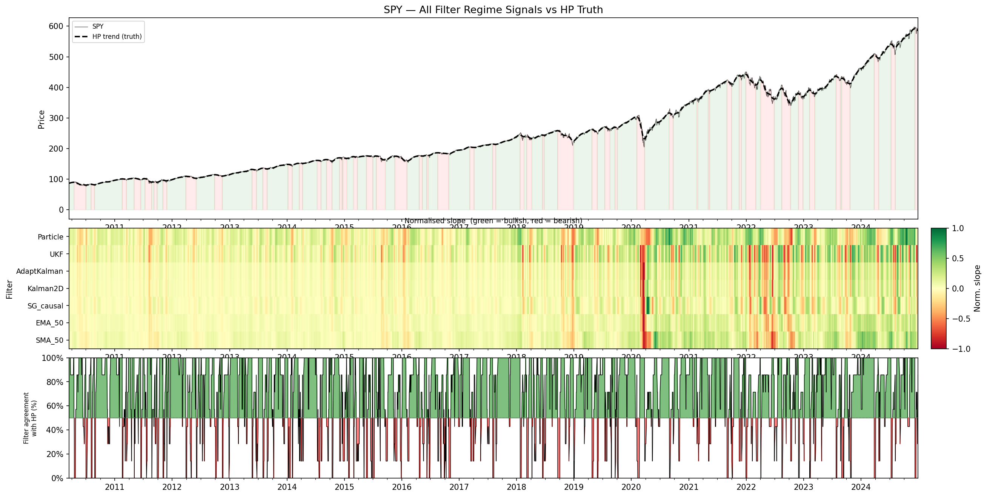
HP Truth – green overshooting, red undershooting

Slide 15
Ideas to be tested
Structural breaks: BCPD; CUSUM
Latent Regime: HMM

Slide 16
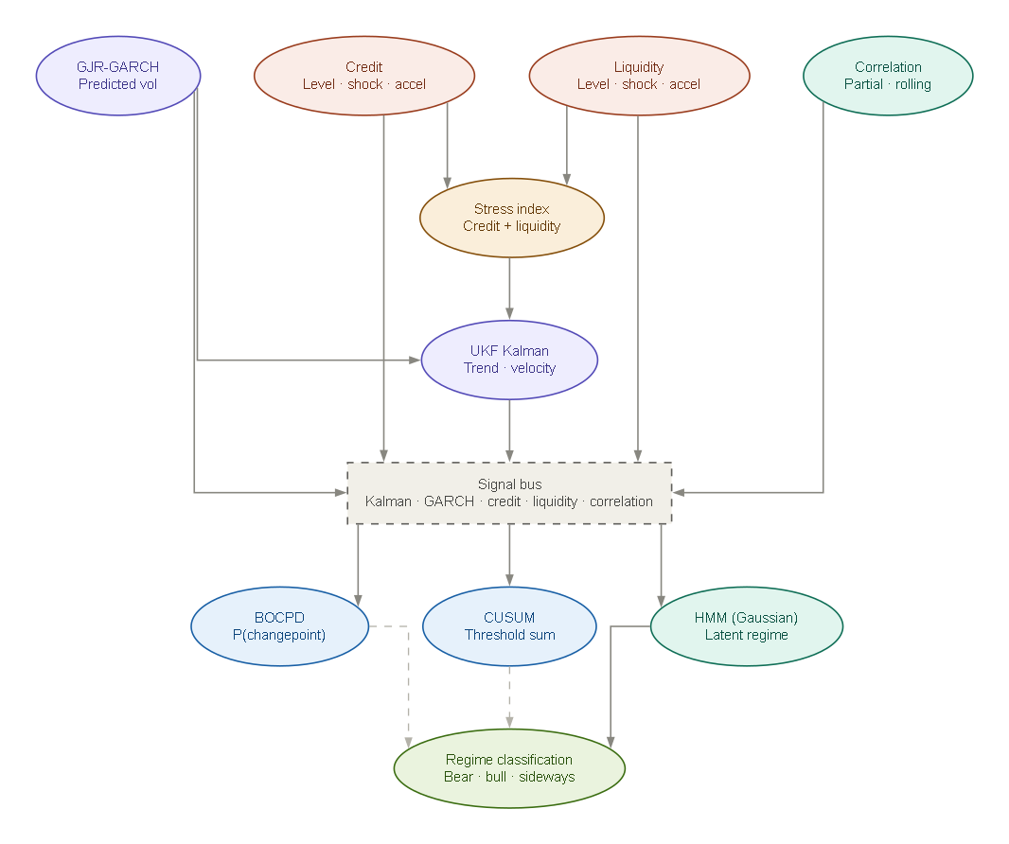
What would a complete system look like?

Slide 17
Where would DCC fit?
Portfolio analytics. DCC does not have predictive power, but is good at managing current positions and risk.

